Slide 1
Large-scale forest rendering: real-time, realistic, and progressive
Thanjida Akhter
201691489

Slide 2
Agenda
Summery of paper
Methods
Tree modeling
Real-time forest rendering
Processing and Transmission
Language And PC configuration
Experiments and results
Comparison
Conclusion

Slide 3
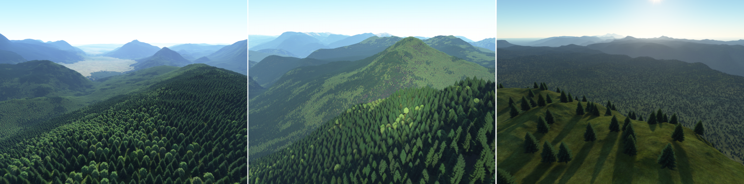
Keywords
Real -time rendering
Video games
Internet graphics
Landscape
Cityscape scene design
Visualization
Web applications
Large forest scene
Natural environment simulation
Animated television production
Online immersive gaming
Visual forestry management.

Slide 4
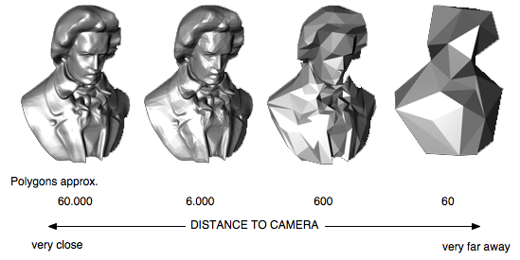
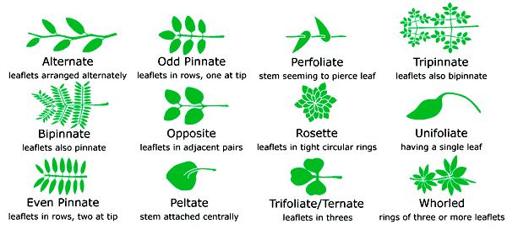
Keywords
Level of details(LOD)
Phyllotaxy

Slide 5
Summery of paper
New framework for rendering large-scale forest :
Integrates extracting LOD tree models
Rendering real-time shadows
Transmitting forest data for network applications
New leaf phyllotaxy LOD modeling method:
Textures
Balancing the visual effect
Model complexity
Hardware instancing method:
Render more levels of LOD models
Limitation of the GPU vertex streams

Slide 6
Methods
Point-/line-based rendering
Image-based rendering(IBR)
Volume-based rendering
Polygon-based rendering
Progressive transmission
Hardware instancing
Shadow mapping

Slide 7
Tree modeling
Leaf phyllotaxy model
Branch model processing
Extraction of plant LOD models

Slide 8
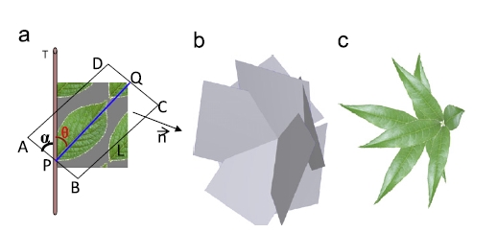
Leaf phyllotaxy model
Leaf length (L)
Leaf width (W)
Angle between a leaf vein and the phyllotaxy axis(θ)
Angle between the leaf and the axis(α)
Leaf number at one node(N)
Leaf direction(β=90-α)
(a) Leaf orientation (b) Mesh model (c) Phyllotaxy

Slide 9
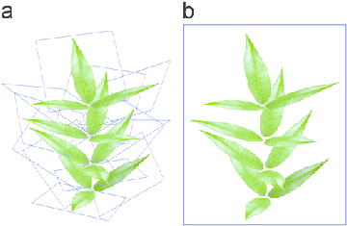
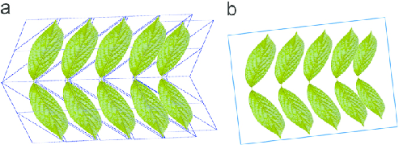
Leaf phyllotaxy model example
L=10.0 cm
N=3
θ =80:0
α=89
L=6.0 cm
N=2
θ =80:0
α=1

Slide 10
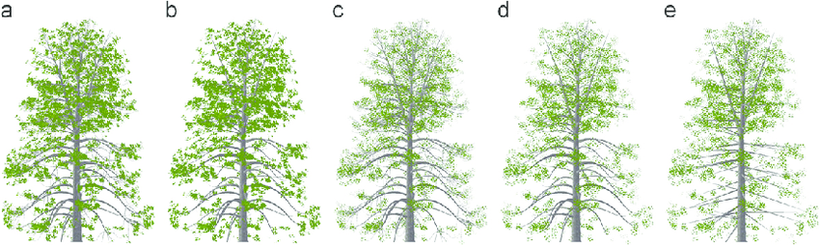
Extraction of plant LOD models
Memory exhausted.
More memory space
Maintaining realism
(a) 24,073 (b) 19,302 (c) 12,667 (c) 4720 (d) 2451

Slide 11
real-time forest rendering
Shadows for large-scale forest scenes
LOD shadow maps generation scheme
Shadows smoothing
2. Hardware instancing
Instancing in the view frustum
Instancing in the light frustums

Slide 12
Hardware instancing
Limited number (n) of separate vertex streams
n is less than four
Only n LOD levels can be determined at once

Slide 13
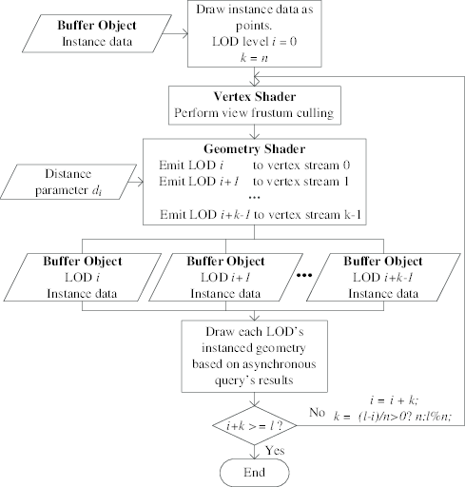
Instancing in the view frustum

Slide 14
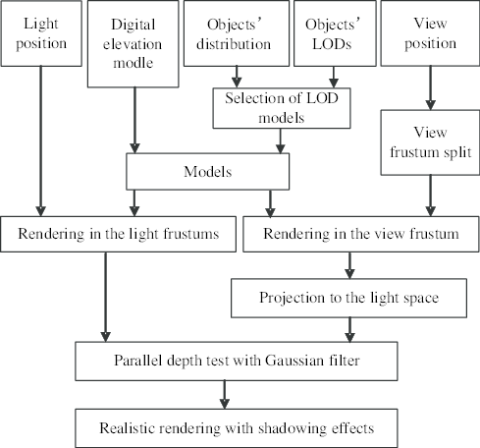
Instancing in the light frustums

Slide 15
Processing
Upload data to server :
Web data transmission
Extracted LOD models
Digital elevation models (DEM)
Scene management files
Data
Save format
Binary files
Compressed in ZIP format
Security passwords.
Upload

Slide 16
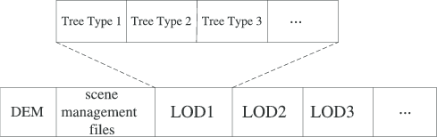
Transmission
Structure of data for transmission
DEM and scene files are transmitted first
Lower resolution trees of all types take higher priority over complex ones.

Slide 17
Language And PC configuration
C++ language with OpenGL
Shaders: OpenGL Shading Language (GLSL).
PC configuration :
Intel Core i7 2.66 GHz CPU
3 GB RAM and a NVIDIA GeForce GTX260 graphic card
896M video memory.
TCP/IP network
images compressed in JPEG format
A DEM image with a resolution of 1024x1024 is 40KB

Slide 18
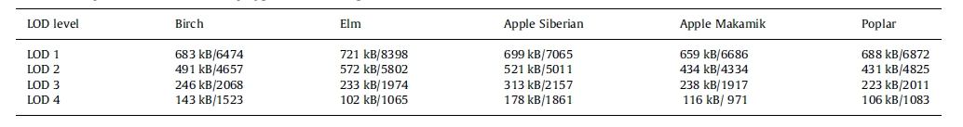
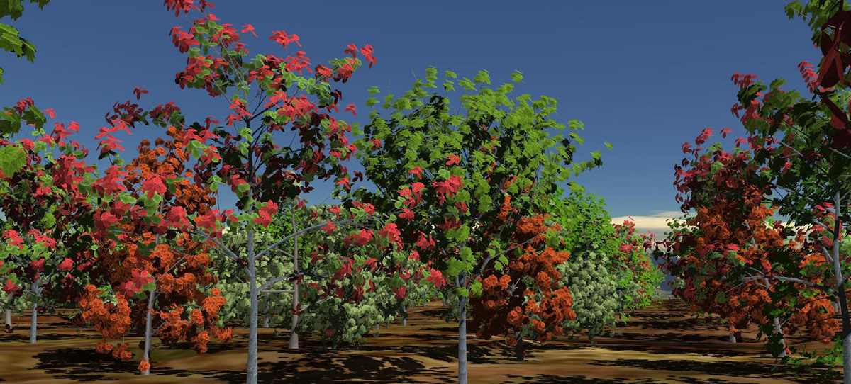
Experiments and results-1
Tree sample model’s data size and polygon number
7446 trees
757 trees with over 1.5 million polygons
View frustum at 33.91 frames per second (FPS).

Slide 19
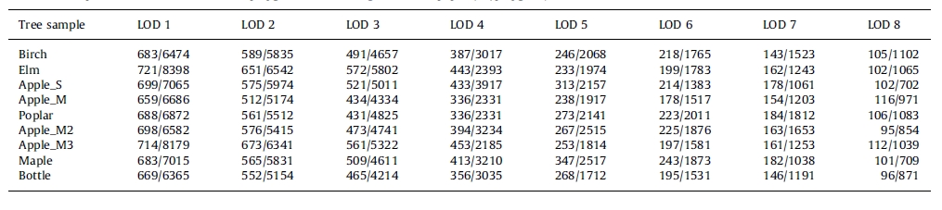
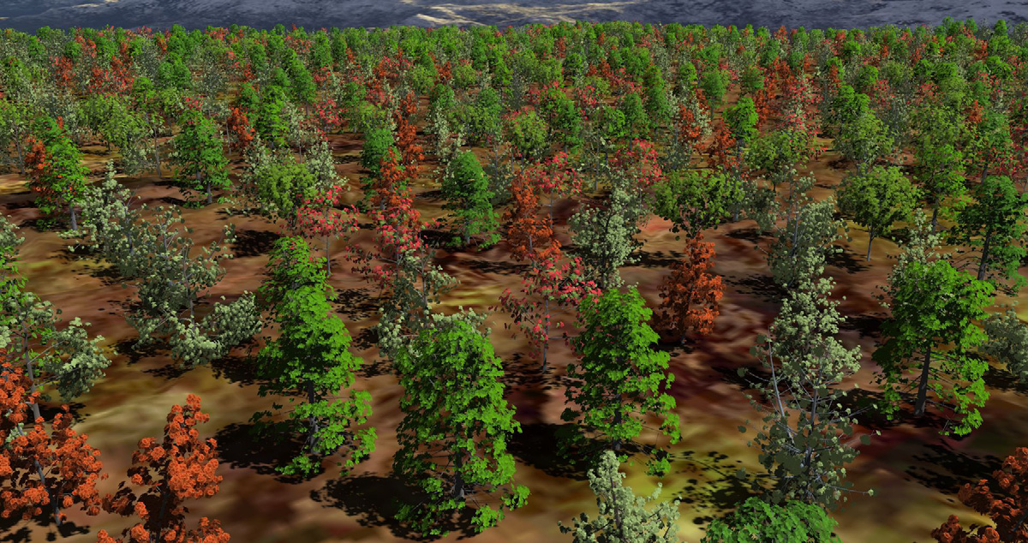
Experiments and results-2
Tree sample model’s data size and polygon number
Nine types of trees
Eight LOD levels
Forest data size is 39.1 MB
Tree models count for 97.3% of the total data

Slide 20
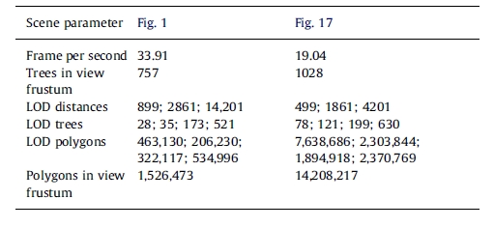
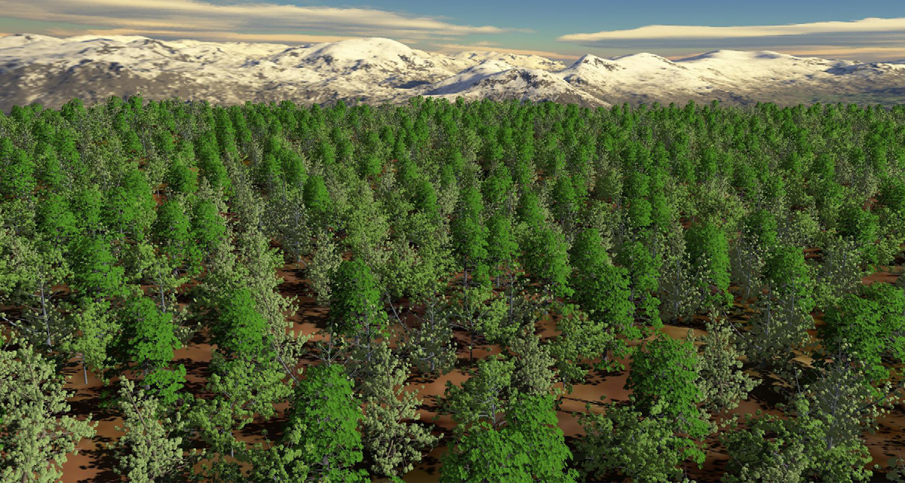
Experiments and results-3
43,000 trees.
1028 trees with over 14 millions polygons
view frustum. FPS is 19.04.
The resolution is 1920 1024 pixels.

Slide 21
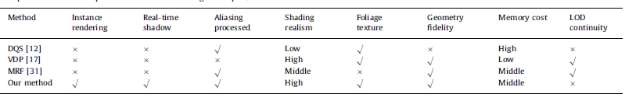
Comparison

Slide 22
Conclusion
Render large-scale forest shadows
Reduces geometric complexity
Saves GPU memory
More levels of detail(LOD)
New leaf phyllotaxy LOD model
Textures
balancing the visual effect
model complexities
The lowest-resolution mode
Lightweight
Easy transmitted
Advance rendered

Slide 23


